Slide 1

Notes:
Slide 1: Title & Team Introduction

Slide 2
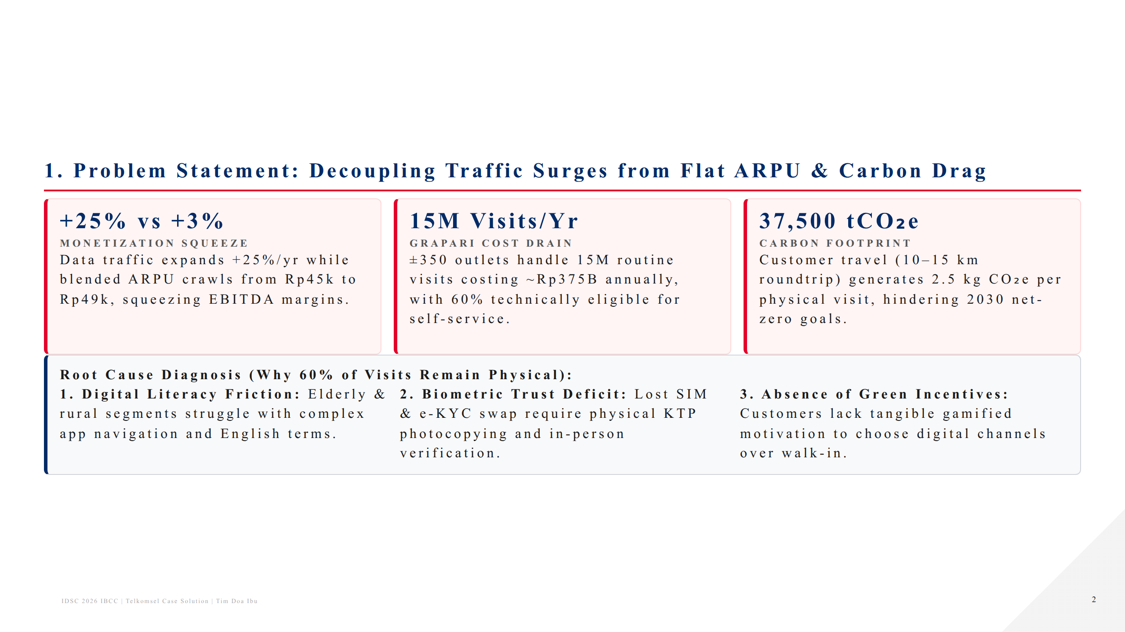
Notes:
Slide 2: Problem Statement & Diagnostic

Slide 3
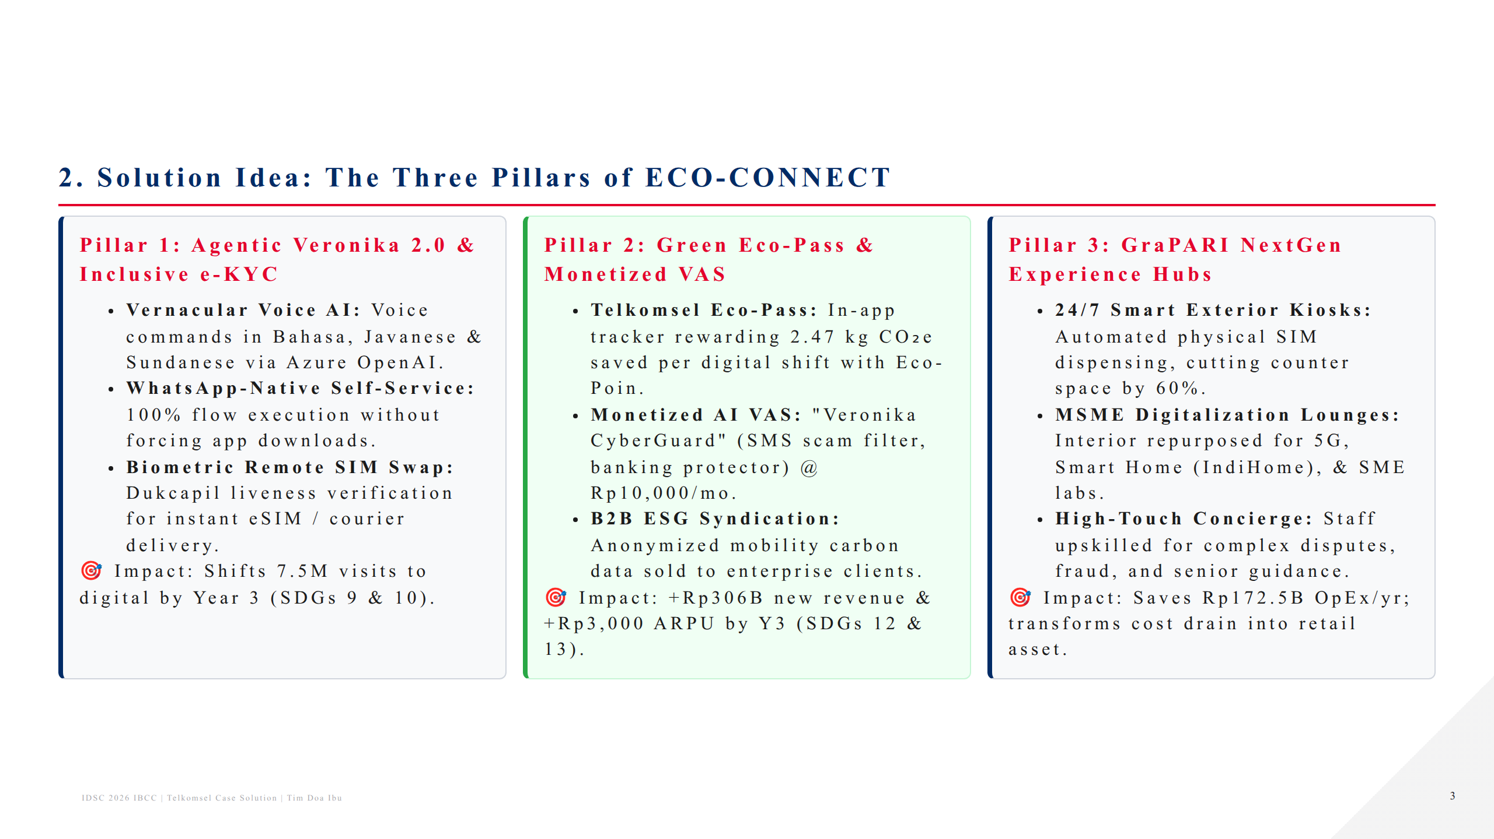
Notes:
Slide 3: Solution Idea: ECO-CONNECT

Slide 4
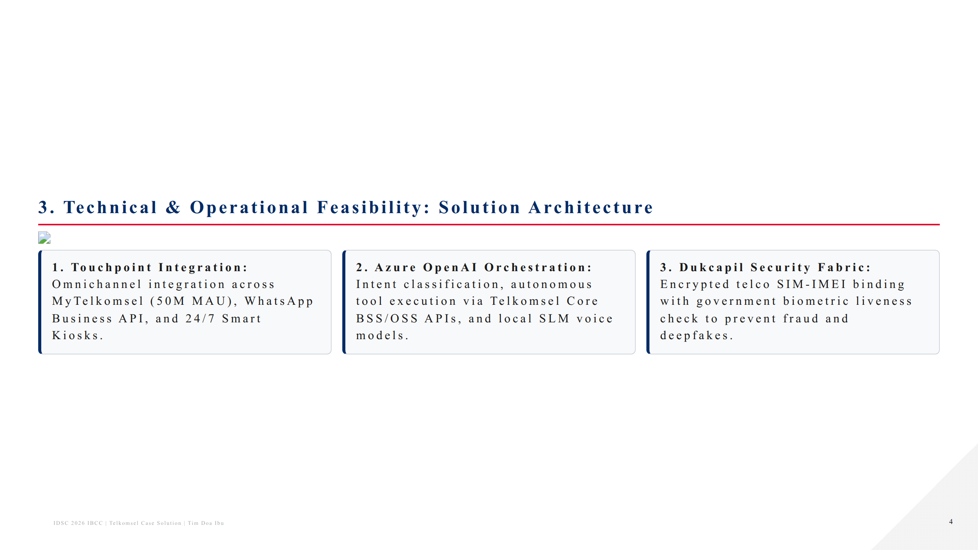
Notes:
Slide 4: Technical & Operational Feasibility

Slide 5
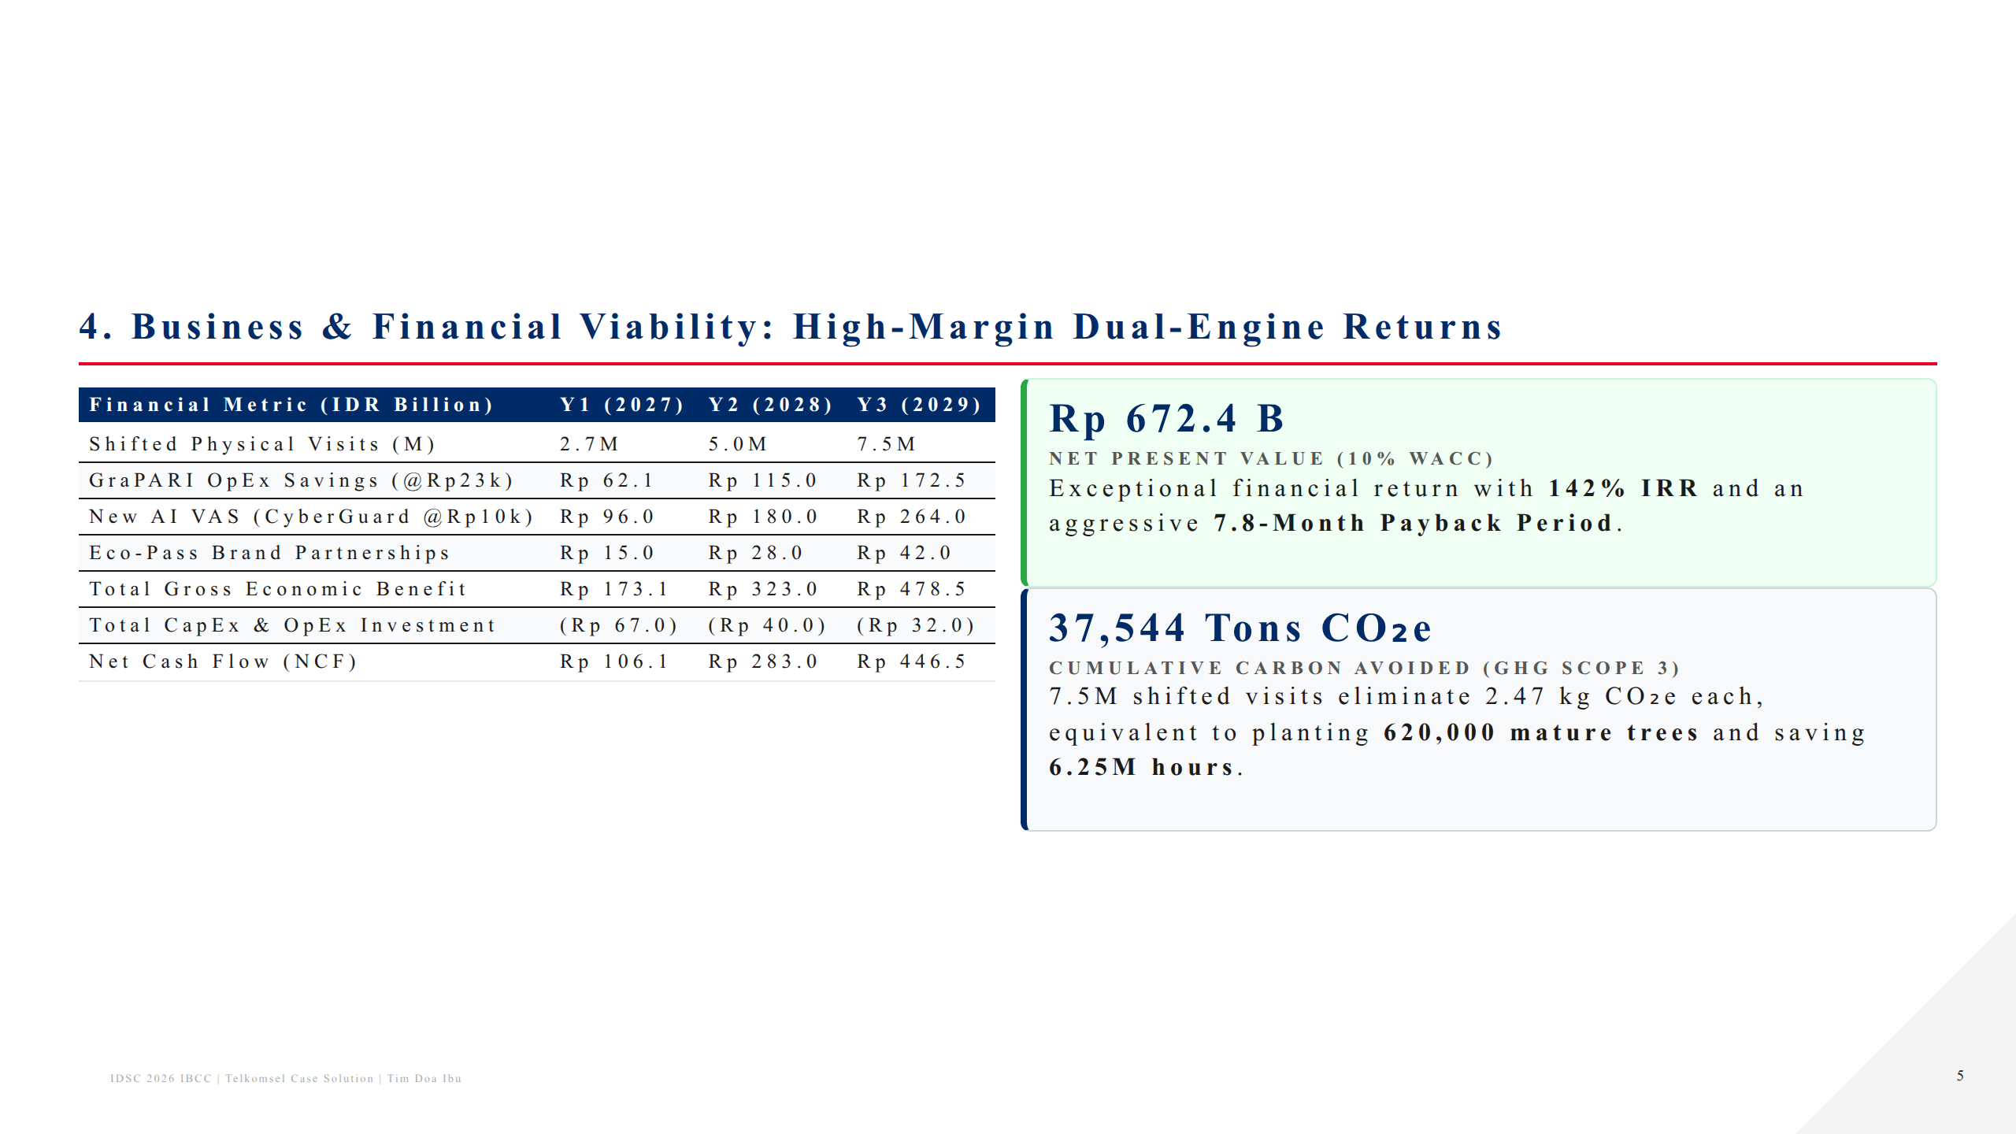
Notes:
Slide 5: Business & Financial Viability

Slide 6
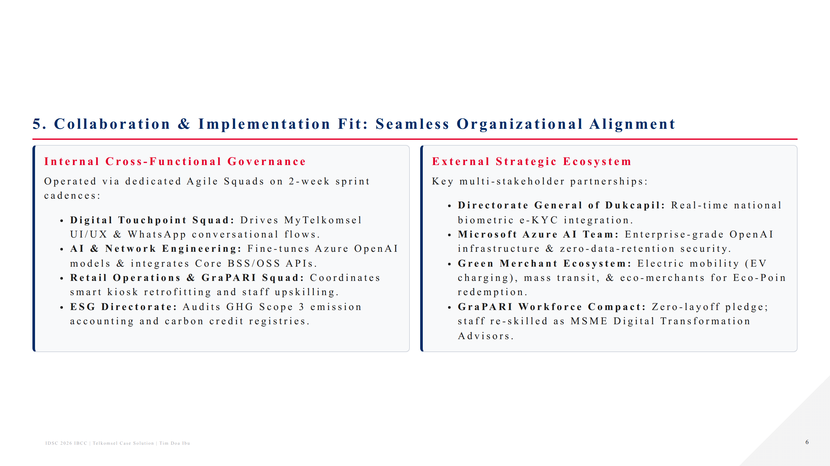
Notes:
Slide 6: Collaboration & Implementation Fit

Slide 7
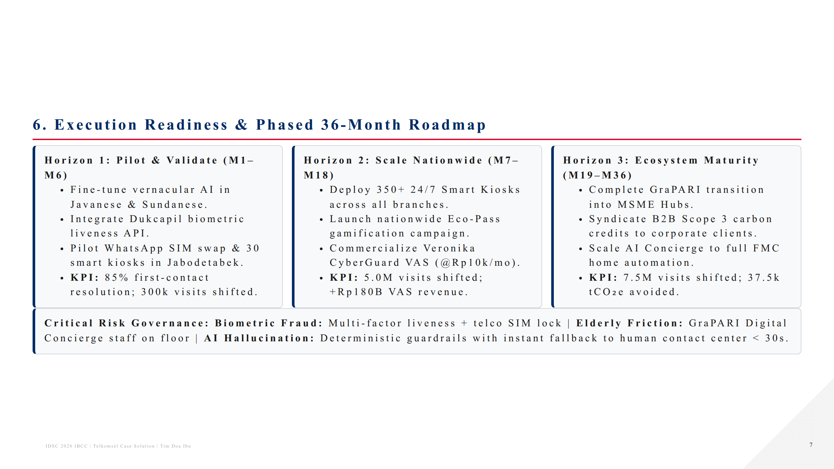
Notes:
Slide 7: Execution Readiness & Roadmap

Slide 8
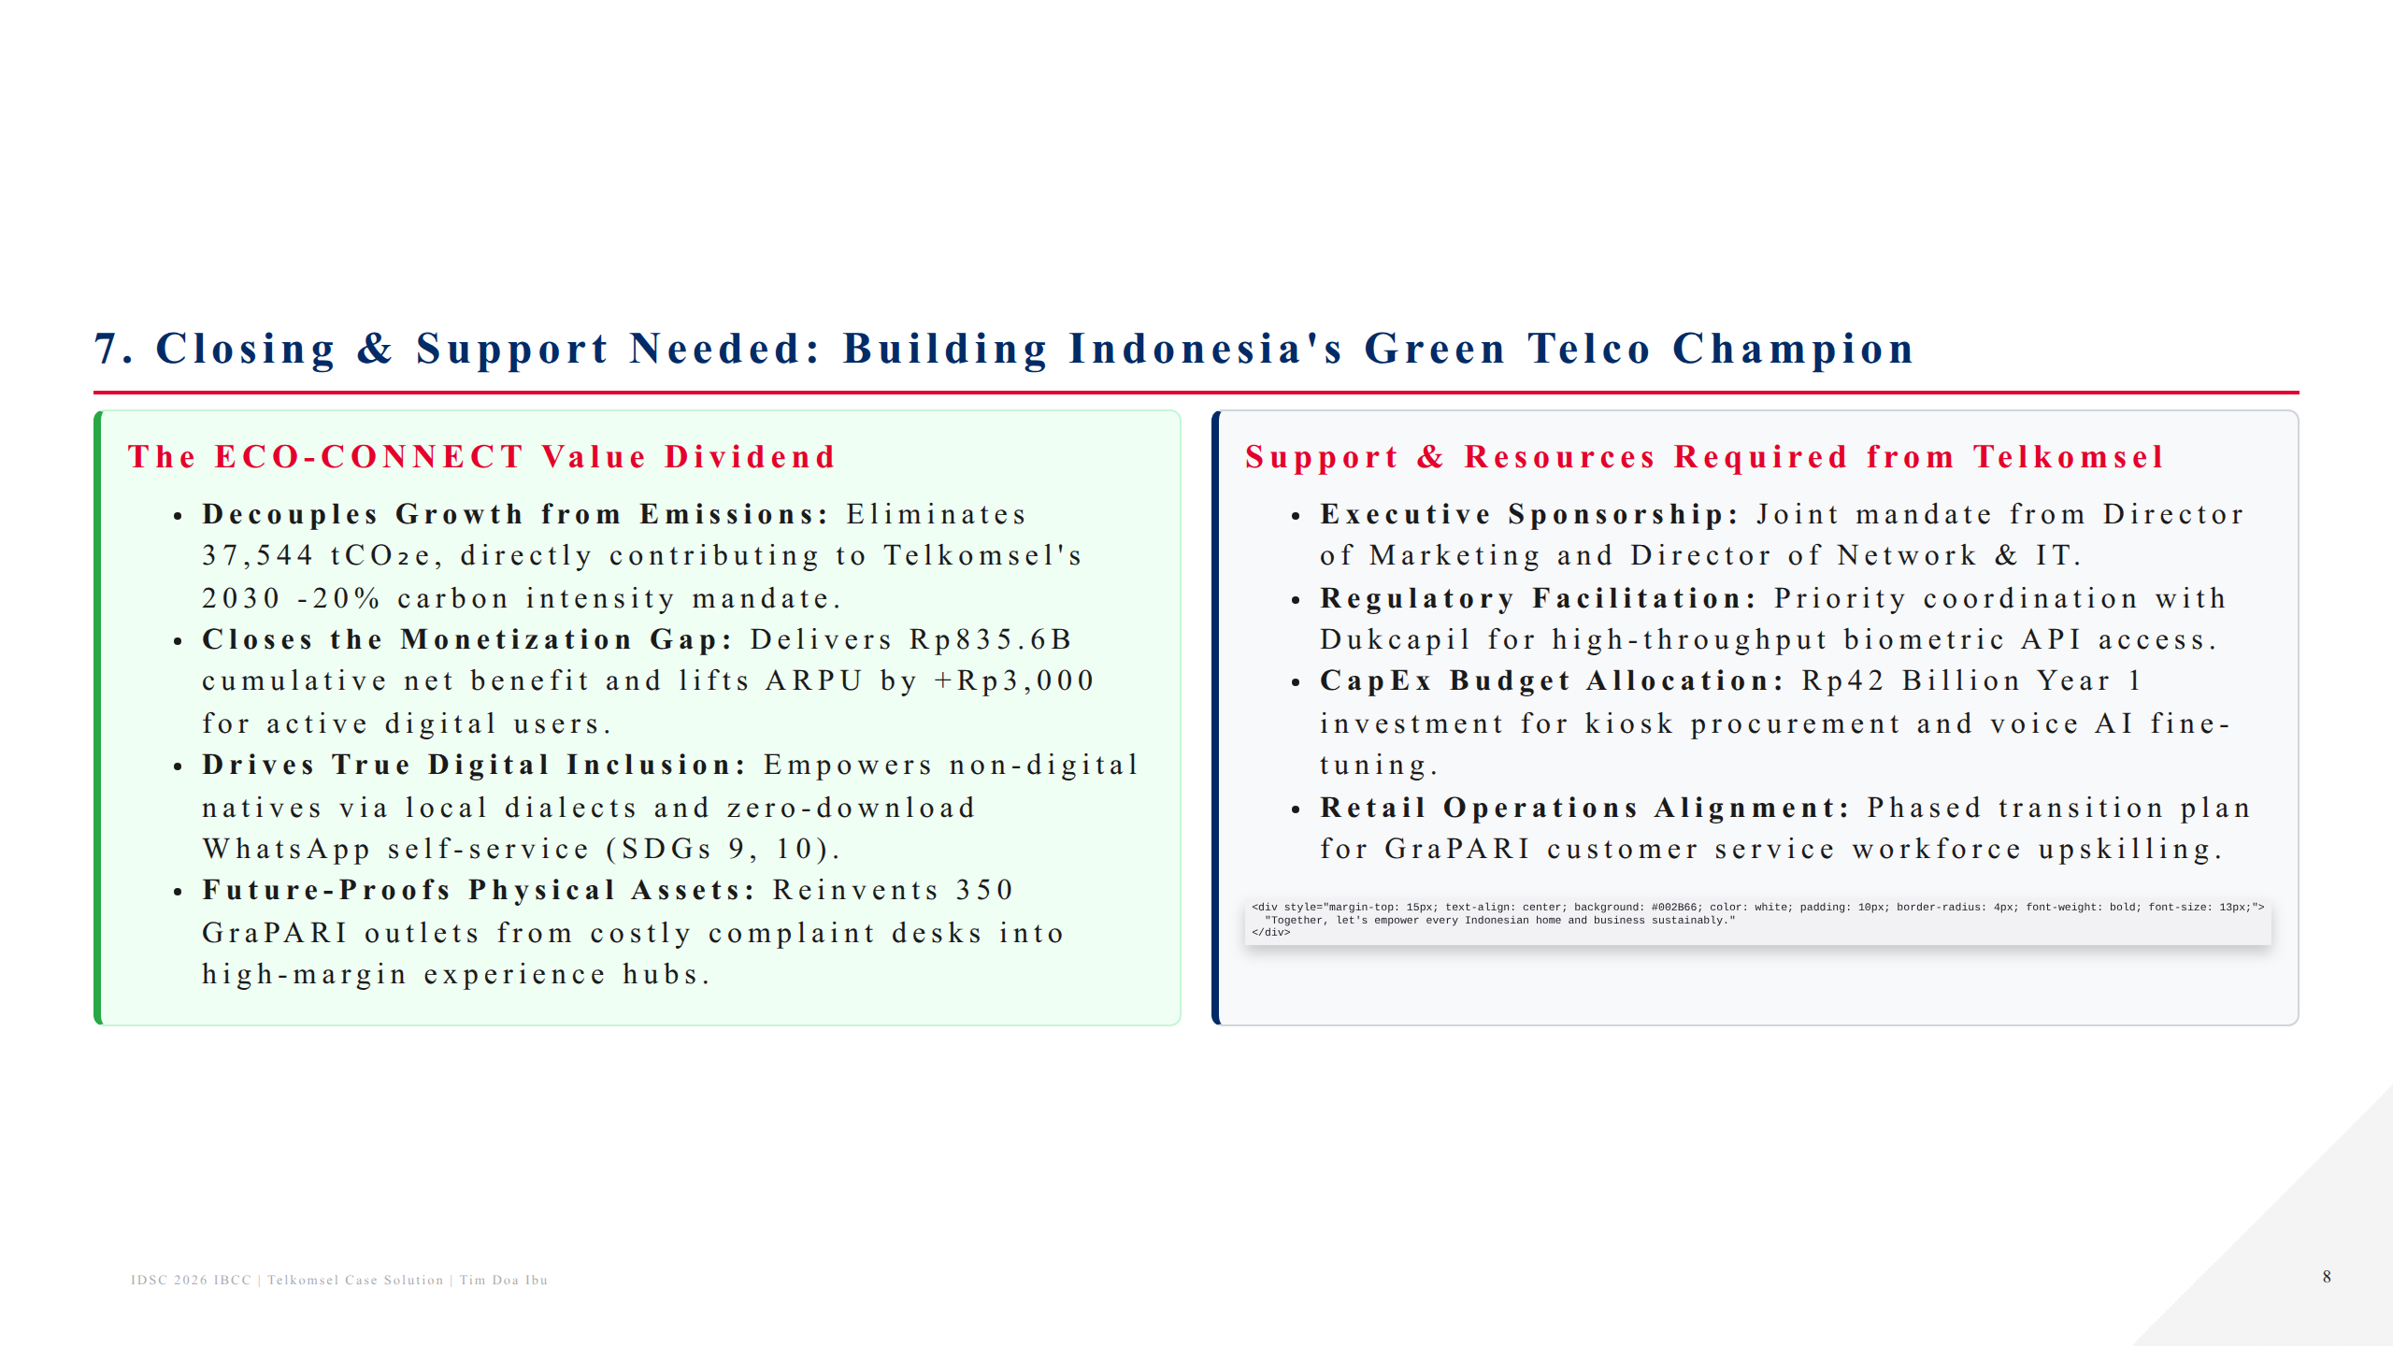
Notes:
Slide 8: Closing & Support Needed

